Slide 1


Automated Post-Patch Application Testing Framework
System Architecture & Execution Flow Blueprint

Slide 2
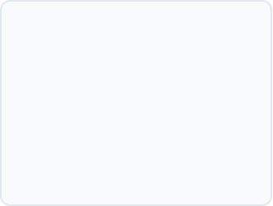
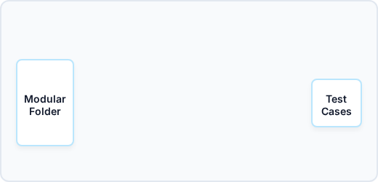
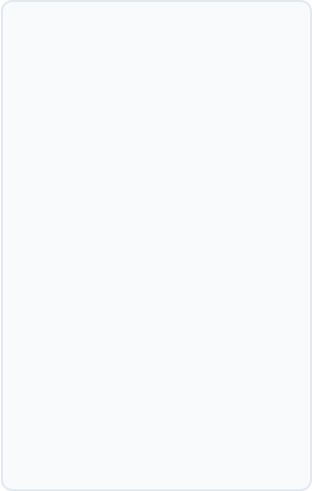







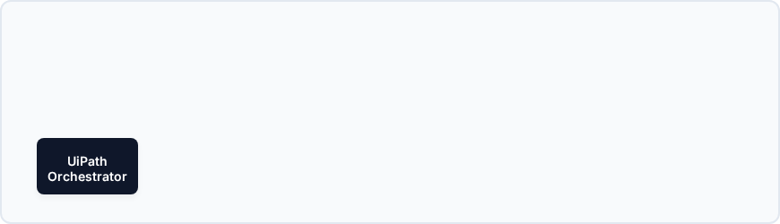
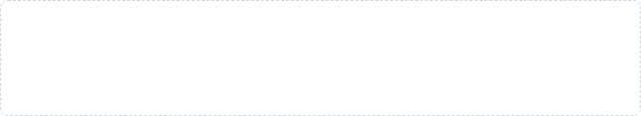












System Architecture Blueprint
1. INITIATION PHASE
2. UIPATH STUDIO: DESIGN
4. TEST MANAGER & ROLLOUT
Outlook Actions
Pass/Fail Dashboard
Trigger?
Teams Actions
No
Yes
Approved for Rollout?
3. ORCHESTRATION & EXECUTION
Outlook Test Path Execution
Success?
Yes
No
Teams Test Path Execution
Success?

Slide 3
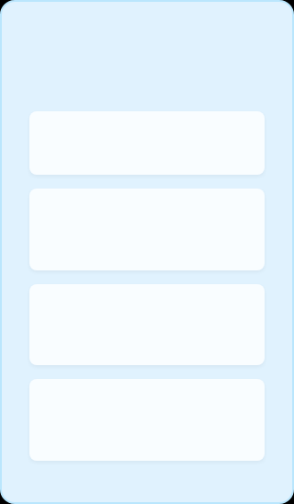

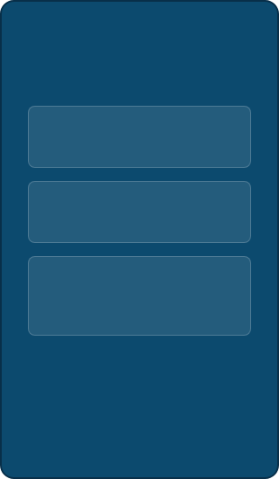





Post-Patch Outlook Test: Behavior-Driven Flow
GIVEN
WHEN
THEN
Pre-conditions & State
Execution Actions
Assertions & Verification
System Rebooted & Patched Successfully
Initialize Outlook Application
UI Remains Stable (Zero Application Crashes)
UiPath Robot Authenticated via Orchestrator
Click "New Email" & Compose
Email Successfully Moves from Outbox to Sent Items
Input Test Recipient & Dynamic Subject
Standardized Test File (PDF) staged in local temp directory
Verify Delivery via Secondary Inbox Check (Optional/API)
Attach Standardized PDF File
Outlook Process Confirmed Closed (Clean State)
Test Manager Result Logged:
Click "Send" Button
or

